Slide 1


6 June 2026
GUEST-OF-HONOR
David Chen
Oliver Jay
Thibault Sottiaux
Chief Product Officer
Shopee
Managing Director, International OpenAI
Head of Codex OpenAI

Slide 2
Seating Arrangements
Food Catering
▲ STAGE ▲
SCREEN
E
GOH
X
17
…
37
I
1
5
9
13
18
…
38
T
2
6
10
14
19
…
39
3
7
11
15
20
…
40
4
8
12
16
21
…
Food Catering

Slide 3
Tool Setup
Wifi Access
ChatGPT Pro Activation
API Credits (USD 100)
NETWORK
1
Log into the ChatGPT Free account you want to upgrade
1
Go to platform.openai.com - log in or sign up.
Shopee-Guest-Devices
STEPS
2
Open the unique promo link from the activation email sent to you
2
For new users: click "Start building" in the top right corner and complete setup steps. You can skip adding members, generating an API key, adding credit card.
1
Select Shopee-Guest-Devices from WiFi list
3
Go to Settings → Billing → Promotions.
2
Browser prompt opens. Select Accept..
Note:
Link is unique to you and can only be redeemed once. Do not share it.
You may be asked to provide a credit card for verification. Subscription will not auto renew.
4
Enter the unique coupon code sent to your email.
3
You're connected!
Note:
Coupon code is unique to you and can only be redeemed once. Do not share it.
For any setup issues, please reach out to our support crew.

Slide 4
Agenda
9:20 AM |  | Opening
10:00 AM |  | Hacking Starts
12:30 PM |  | Working Lunch
2:30 PM |  | Tea Break
5:00 PM |  | Code Submission Deadline
5:00 PM - 7:15 PM |  | Dinner + First Round Judging
7:15 PM |  | Final Round (Top 5)
8:30 PM |  | Prize Presentations
9:00 PM |  | End of Event

Slide 5
Build Directions
Autonomous &
Adaptive AI
01
AI-Native Products
& Operations
02
Deep Domain AI
03
Agents that operate reliably without constant human oversight
Products, services, and operations fundamentally redesigned with AI - or something that simply couldn't exist before
AI that reflects how expert work is actually done - not a simplified version
What we're looking for
What we're looking for
What we're looking for
Is this an agent you can trust to run autonomously - and does it get better the more it runs?
What can users or businesses now do that wasn't realistically possible before?
Would a domain expert trust this to do their job?

Slide 6
Judging Criteria
01
02
03
Problem & Solution Fit
Build Quality
Insight & Originality
Is the problem real?
Is the solution the right answer to it?
Does it work and hold up under use?
We judge the product - not the pitch.
Is the approach genuinely novel, or just common industry practice?
04
05
06
Real-World Value
Alignment with Build Direction
Use of Codex
Based on the working demo - who benefits, and how significantly?
Does the build meaningfully reflect at least one build direction?
How deeply was Codex leveraged to build this product?

Slide 7
Judging Process
PRESENTATION FORMAT (APPLIES TO BOTH ROUNDS)
6 min Demo / Pitch
2 min Q&A
Cover your problem, solution, and use of Codex. Judges will score against the criteria shared - grounded in what you built and can demonstrate.
ROUND 1
ROUND 2
Preliminary
Finals
All teams
Each team presents to a dedicated pair of
Sea & OpenAI judges
Top 5 teams
Present on the main stage in front of
all participants & a panel of final judges
TOP 5 ADVANCE TO FINALS
TOP 3 ANNOUNCED AFTER THIS ROUND

Slide 8
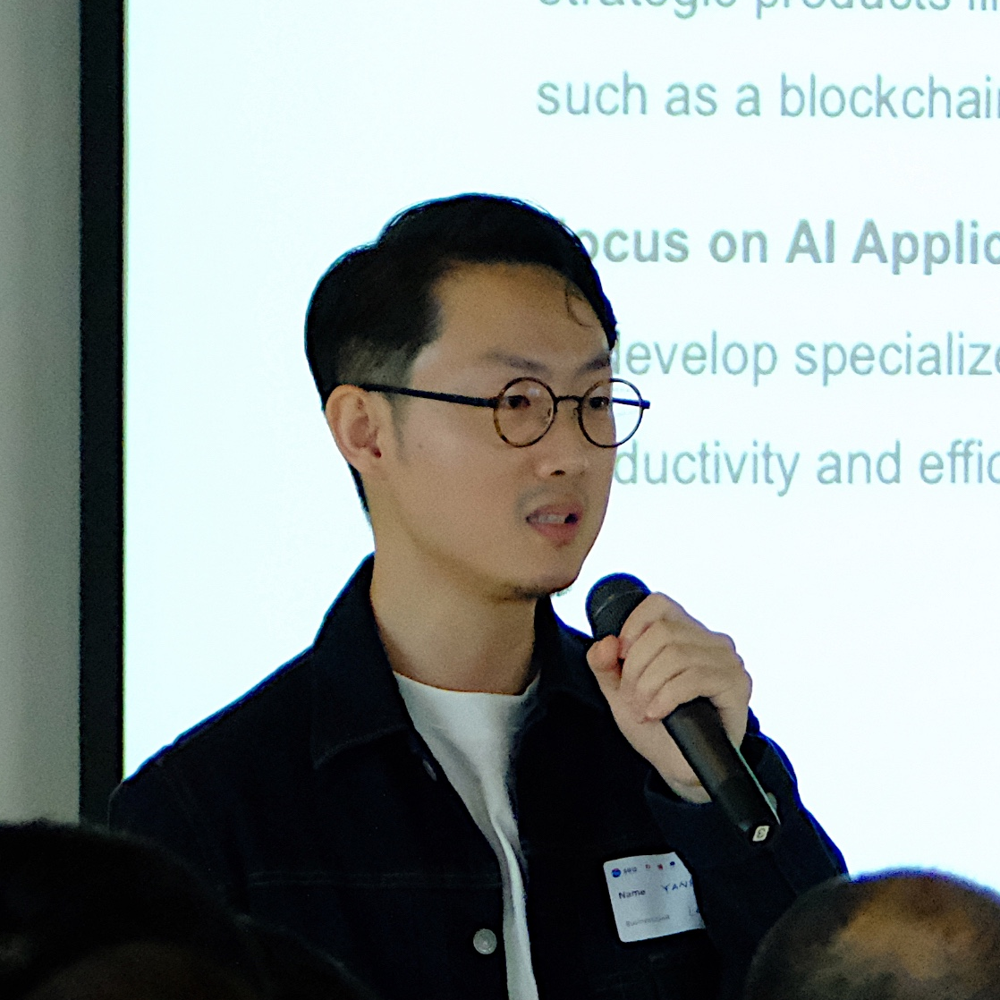
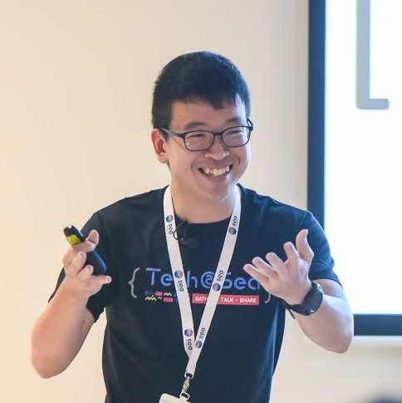
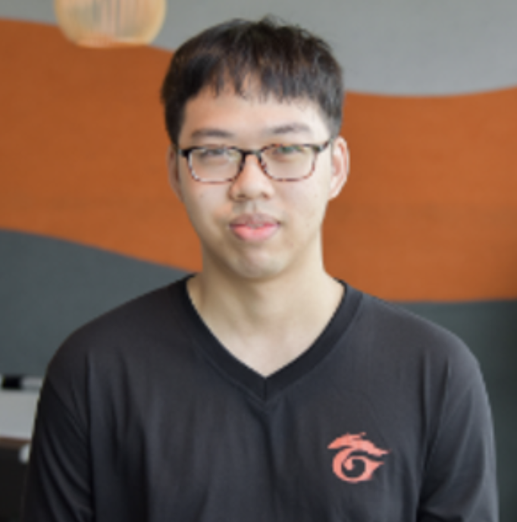
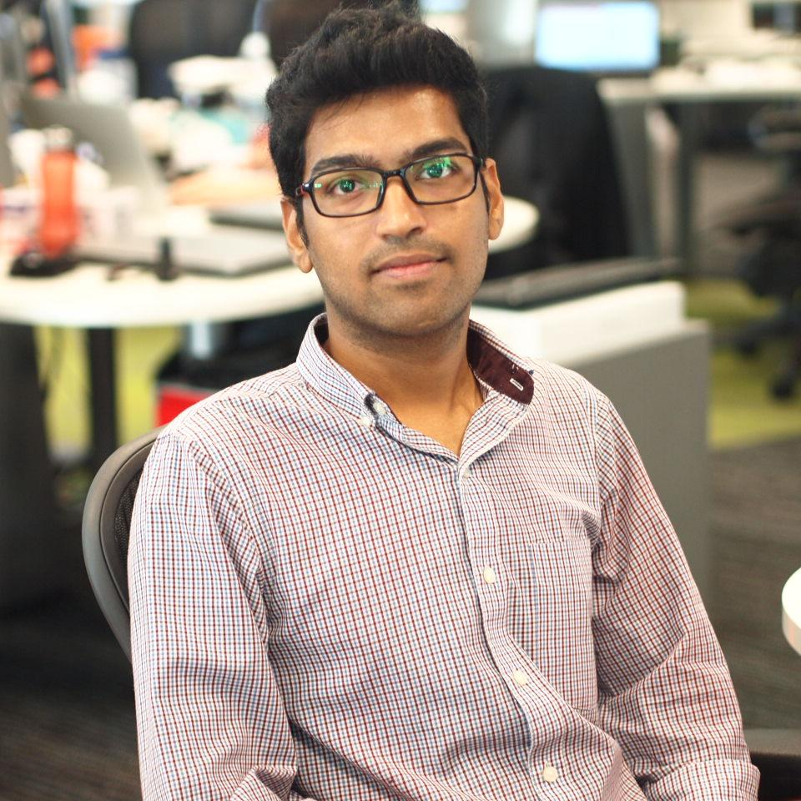
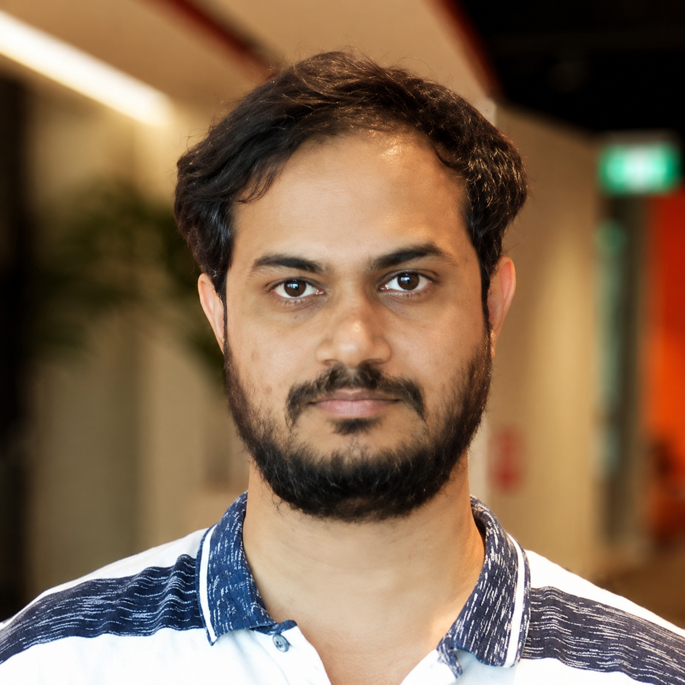
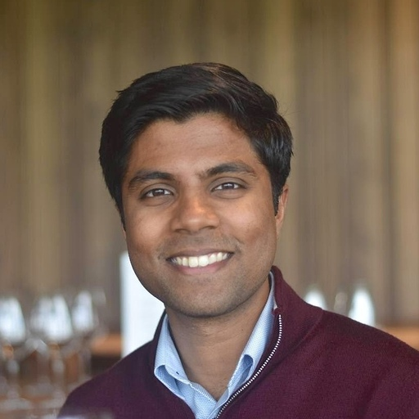
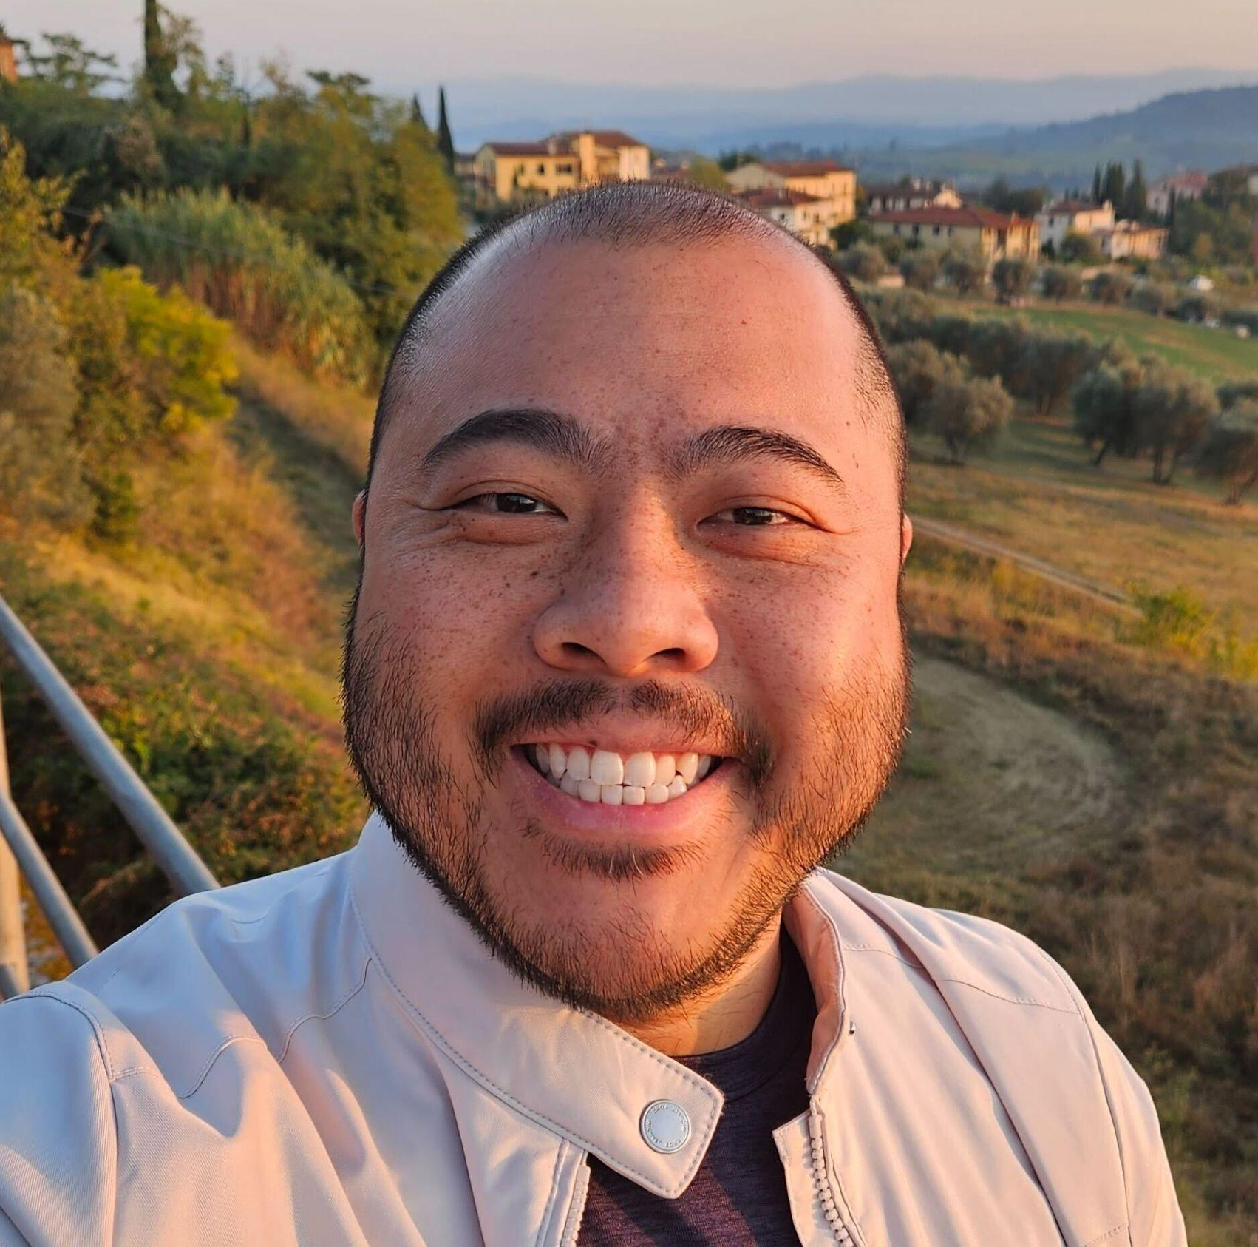
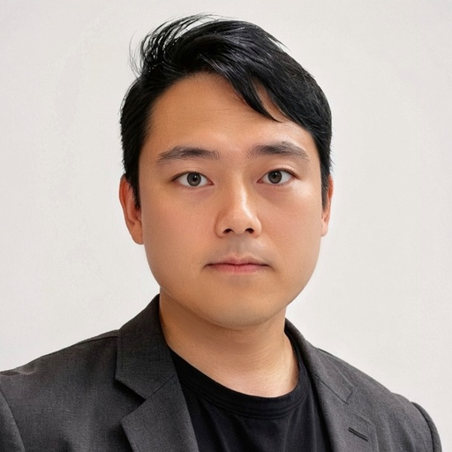
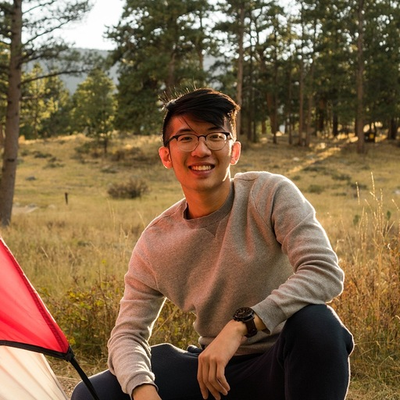
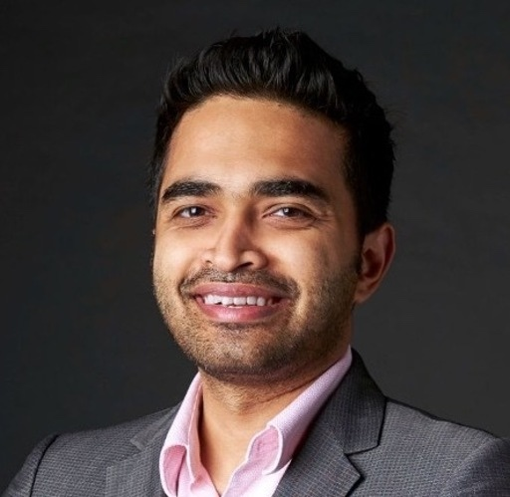
Round One Judges
Yang Bo
Kelvin Ang
Terence Then
Amulya
Krishna Kannan
Sea
Sea
Sea
Sea
Sea
Sharan Thangavel
Kevin Chan
Tyler Ryu
Zac Tan
Indranil Sarkar
OpenAI
OpenAI
OpenAI
OpenAI
OpenAI

Slide 9
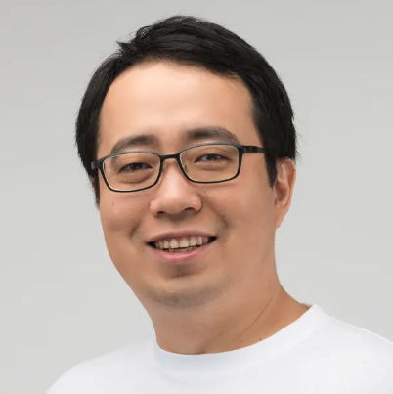
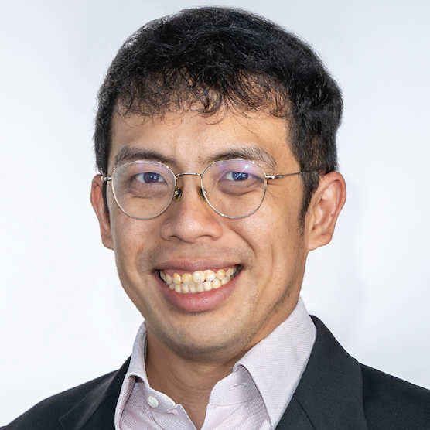
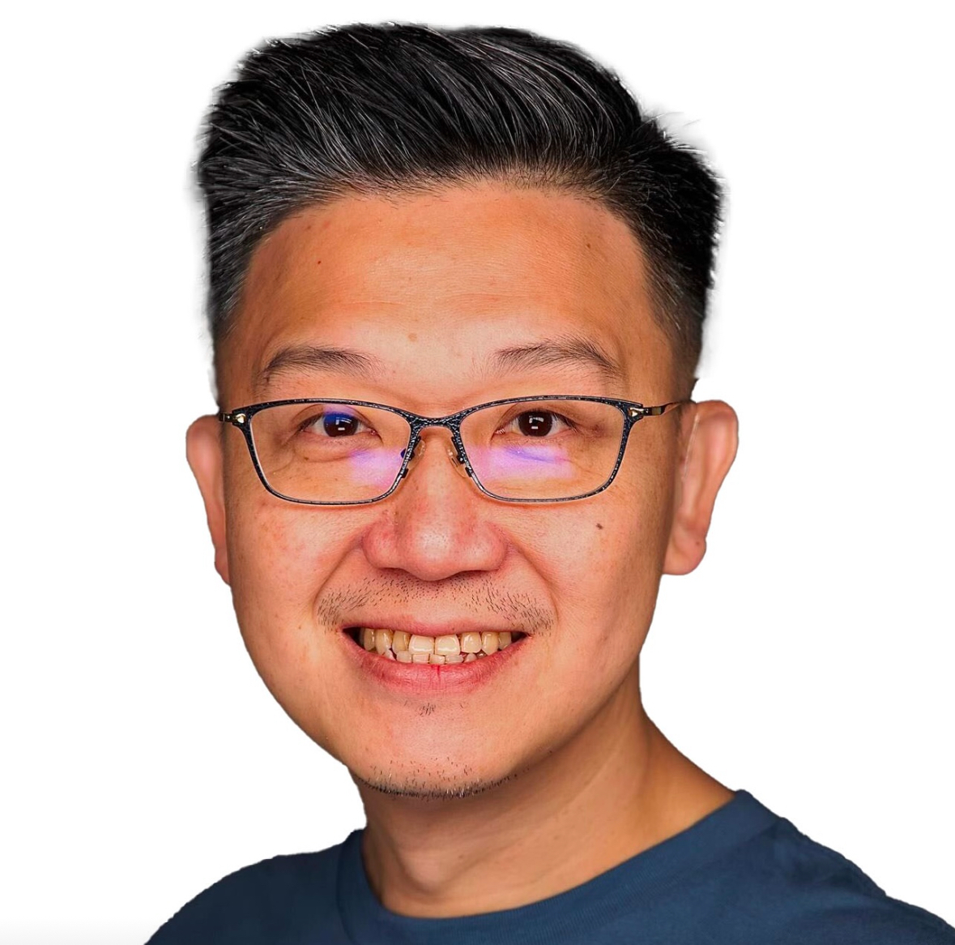
Final Round Judges
David Chen
Chief Product Officer
Shopee
Dr He Ruimin
Chief AI Officer
Ministry of Digital Development and Information
Albert Yip
Head of Technical Success (APAC)
OpenAI

Slide 10
Hackathon Rules
All work must be done on-site.
Building on existing project
Allowed only if:
You may either:
New extensions are significant and substantial. Only work built during the hackathon will be judged.
01
02
Built in a new public repository.
Start from
scratch
Build on an existing
personal or
open-source project
Link to the existing repository / repositories must be provided in your README and submission form.
State clearly what was built during the hackathon in your README and submission form.
Any infringement of these rules may result in disqualification.

Slide 11
What to Submit
Each team to make one submission via Google Form by 5:00 PM sharp - Late submissions will be disqualified.
01
02
03
04
GitHub Repo
Project Writeup
Demo Link
Declarations
New public repository created for this hackathon
Written summary of the problem, solution, build direction it aligns with, and how Codex was utilised.
Live demo or prototype link (optional)
State any existing OSS / personal project used, and what was built exclusively within this hackathon

Slide 12

Submission Form

Slide 13
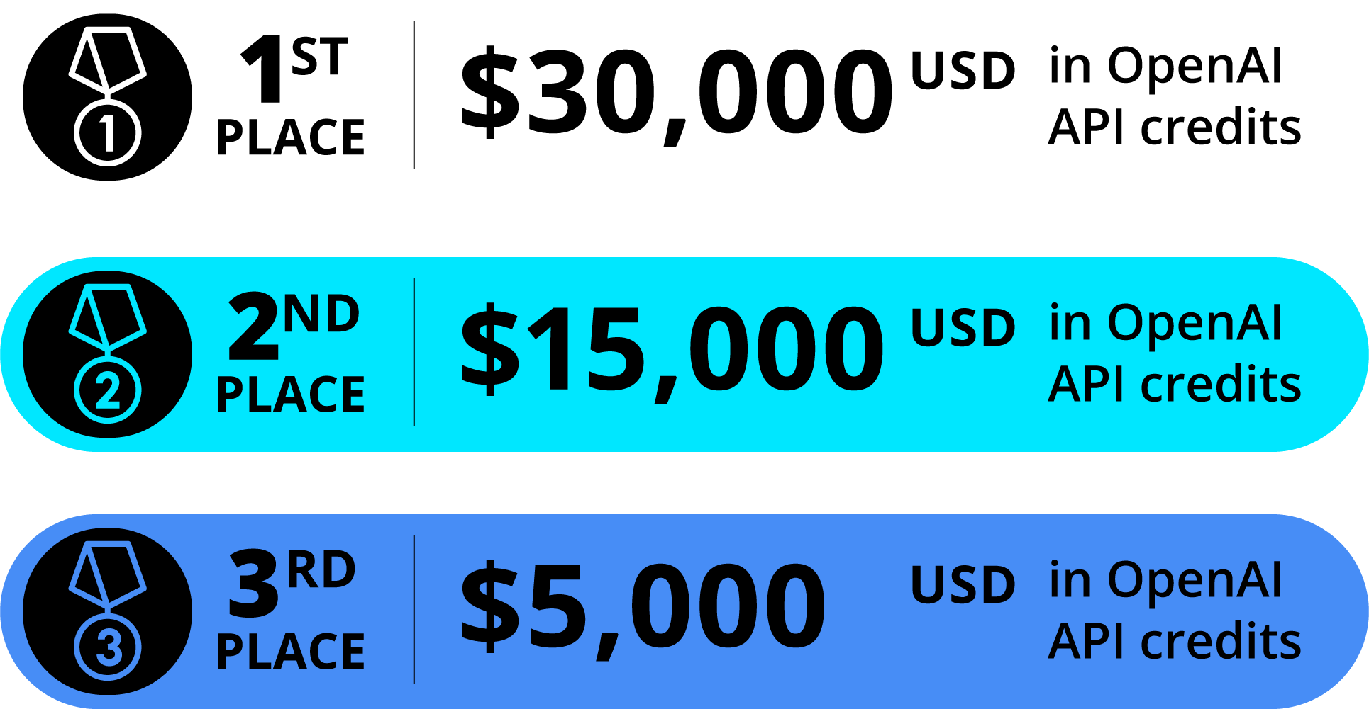
Prizes

Slide 14
Share the Moment
Tag us at Sea and OpenAI on LinkedIn!
🛠
👥
🔥
What are you building?
Who's on your team?
Why does this matter?
Share a screenshot, demo, or describe the problem you're solving.
Tag your teammates. Shout them out.
Real-world impact of what you're solving.

Slide 15


Need Help?
Wave us over
Live FAQ doc
Spot anyone in an OpenAI × Sea t-shirt and wave us over - we'll come to you.
Access the shared doc here to check for latest FAQs through the session.

